Slide 1
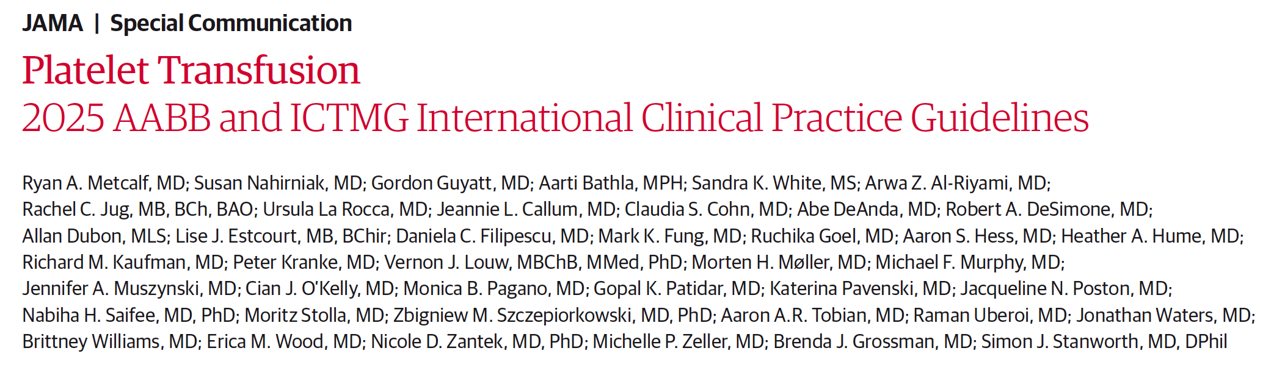
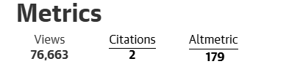

Collaboration with
Published Online: May 29, 2025
2025;334;(7):606-617. doi:10.1001/jama.2025.7529
(on August 19, 2025)
Notes:
A slide to introduce the guideline publication

Slide 2



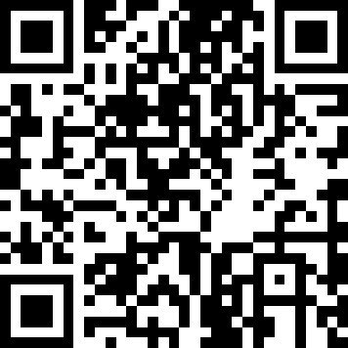
Conducting and disseminating evidence-based practice guidelines through international collaboration
Platelet transfusion guideline 2025
Eleven evidence-based recommendations for platelet transfusion; 4 strong and 7 conditional recommendations support a restrictive transfusion strategy.
Consistent evidence across patient populations shows no clear harm associated with restrictive approaches. Restrictive strategies reduce transfusion‑related adverse events, preserve platelet supply, and lower healthcare costs.
Support local implementation through accessible education resources, including podcast, case studies and more.
Metcalf RA, et al. Platelet Transfusion: 2025 AABB and ICTMG International Clinical Practice Guidelines. JAMA. 2025;334;(7):606-617.
Visit ICTMG.org
& learn more
Guideline & dissemination partners
Notes:
A slide to highlight the guideline, its 11 recommendations, the main guidance and links to the guideline publication as well as resources on ICTMG website

Slide 3
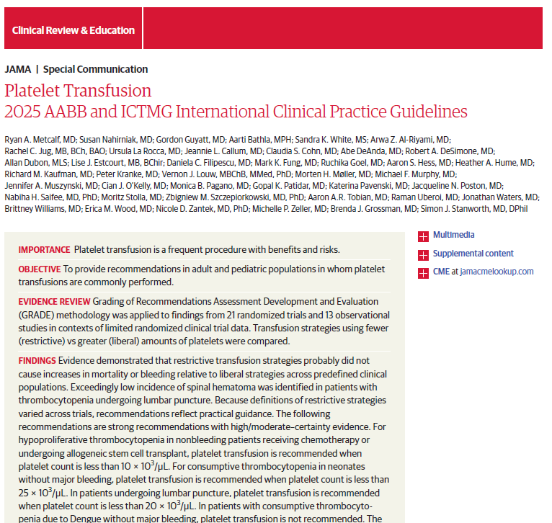

AABB & ICTMG Platelet Guideline
Provides clinicians with actionable, evidence-based recommendations on indications for platelet transfusion.
Overall message of the guideline
No clear evidence of harm using restrictive strategies.
Advocates for restrictive platelet transfusion strategies with practical recommendations for implementation.
Benefits of restrictive strategies:
        Minimizing transfusion-related adverse events.
        Maintaining adequate platelet supply for situations likely to yield important benefits (e.g., major bleeding).
        Reducing healthcare expenditures.
Scan to access the guideline (ICTMG.org)
Source: jamanetwork.com/journals/jama/article-abstract/2834703
Notes:
A slide to highlight the guideline, the overall message and links to resources on ICTMG website

Slide 4

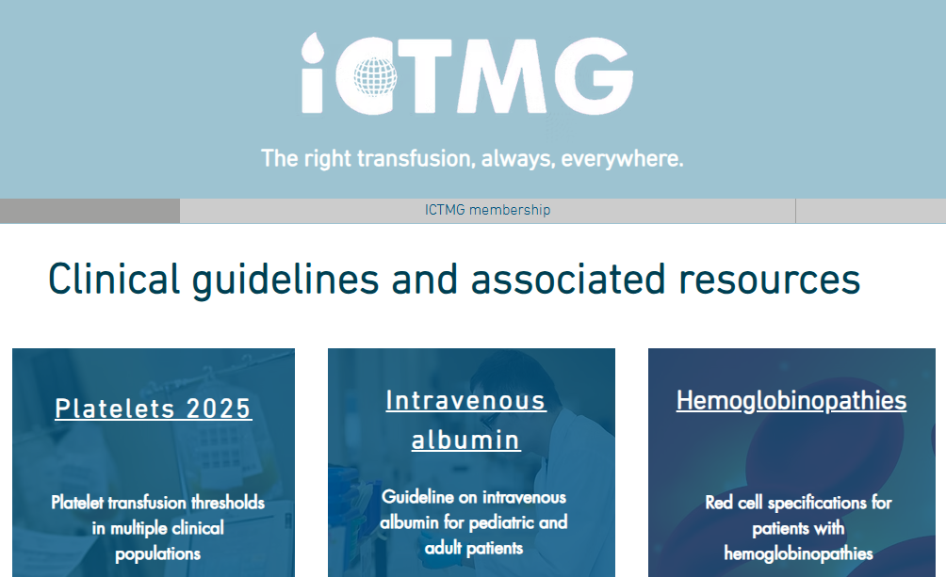

For more information about ICTMG and this platelet guideline
Visit www.ICTMG.org
Contact info@ictmg.org
Scan to access ICTMG.org
Notes:
For more information on the platelet publications and to access the additional resources for physician and patients, visit www.ICTMG.org or email info@ictmg.org.

