Slide 1
The International Collaboration for Transfusion Medicine Guidelines (ICTMG) has created this slide deck to support knowledge mobilization for this guideline.
We encourage the use of this deck by health-care professionals for education or training purposes.
Kindly use the material under the following conditions:
  Cite the ICTMG as a reference.
  Use the ICTMG logo on these slides in your presentation.
  Do not modify the ICTMG statement of recommendations.
  Do not modify the slide content.
Notes:
Notes for presenter.

Slide 2
Disclaimer & disclosures
  The ICTMG guidelines should be used in the context of applicable medical, legal and ethical requirements in any individual case.
  ICTMG receives funding from Canadian Blood Services. Canadian Blood Services does not influence the content of the guidelines.
Presenter disclosures
(*presenter to insert COI’s here, if applicable)
Notes:
Note for presenter: insert relevant disclosures prior to presentation, if applicable.

Slide 3
Intravenous albumin
Use of intravenous albumin for pediatric and adult patients
Slides prepared November 2025

Slide 4
What is intravenous albumin?
Intravenous albumin is:
A human-derived blood product manufactured from donated plasma.
Used in a wide range of clinical settings to improve hemodynamics, facilitate fluid removal, manage complications of cirrhosis with highly variable practice between regions.
More expensive to manufacture and provide to patients compared to crystalloids.
Associated with adverse consequences in some cases including fluid overload, hypotension, hemodilution requiring red blood cell transfusion and anaphylaxis.

Slide 5
What evidence is available to guide albumin use?
Intravenous albumin is administered in a wide spectrum of clinical scenarios, while very few indications have an evidence base that supports its routine use in practice.
ICTMG's 2024 albumin guideline provides evidence-based recommendations for appropriate use of albumin in
adult and pediatric patient populations undergoing:
cardiovascular surgery
kidney replacement therapy
complications of cirrhosis
critical illness (e.g., intensive care, sepsis)

Slide 6
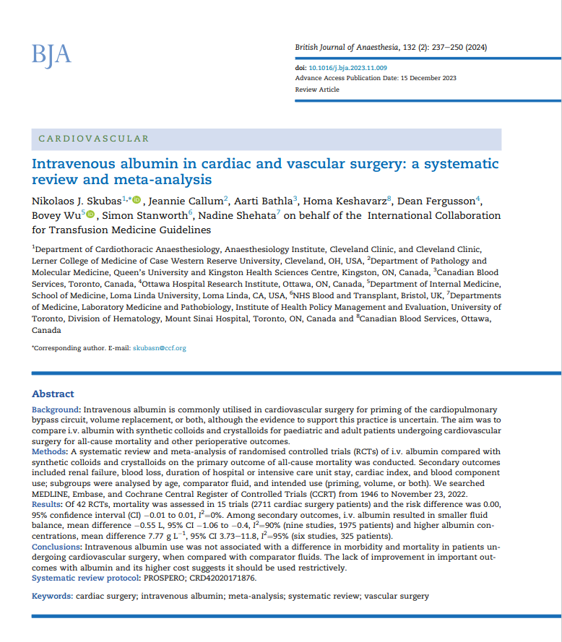
ICTMG’s albumin publications
Systematic review & meta-analysis:
Compares intravenous albumin with synthetic colloids and crystalloids for pediatric and adult patients undergoing cardiovascular surgery.
Outcomes assessed:
Primary: all-cause mortality
Secondary outcomes: renal failure, blood loss, duration of stay (hospital or ICU), cardiac index, blood component use
Conclusions:
Lack of improvement in outcomes + high cost suggest intravenous albumin should be used restrictively.
Source: https://doi.org/10.1016/j.bja.2023.11.009
Notes:
As an independent collaborative of volunteers with expertise in transfusion medicine and related clinical disciplines, guideline development methodology and implementation research, the ICTMG's mission is to optimize patient outcomes through evidence-based international transfusion guidance development and relevant local implementation.
In December 2023, the ICTMG’s systematic review and meta-analysis of intravenous albumin in cardiovascular surgery was published in the British Journal of Anesthesia (available as an open access publication). This publication was a precursor to the development of a clinical guideline on intravenous albumin use, which was published in March 2024.

Slide 7
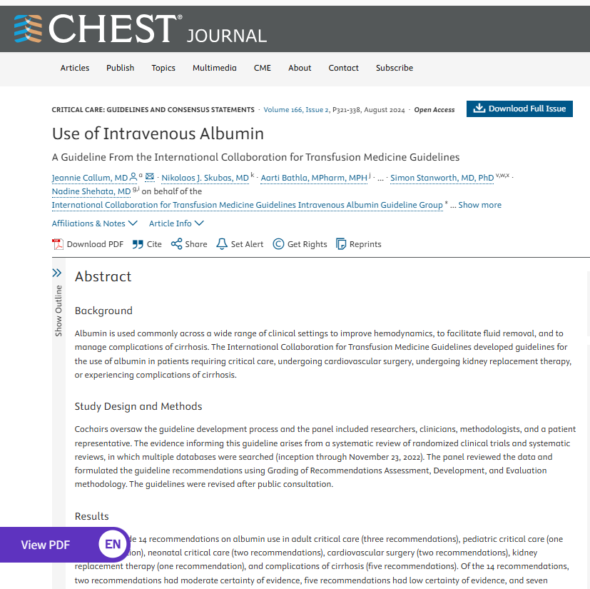

ICTMG’s albumin publications
Guideline:
Provides clinicians with actionable recommendations on indications for albumin use.
Received endorsement by:
  International Society for Blood Transfusion (ISBT)
  [Canada] National Advisory Committee (NAC) on Blood Products
  [Italy] Società Italiana di Medicina Interna (SIMI)
Conclusion:
12/14 recommendations do not suggest albumin use in a wide variety of clinical situations where albumin commonly is transfused.
Scan to access the guideline on ICTMG.org
Source: https://pubmed.ncbi.nlm.nih.gov/38447639/
Notes:
In March 2024, the ICTMG's guideline on intravenous albumin use was published in CHEST (Use of Intravenous Albumin: A Guideline From the International Collaboration for Transfusion Medicine Guidelines - PubMed (nih.gov). The guideline is available as an open access publication.

Slide 8
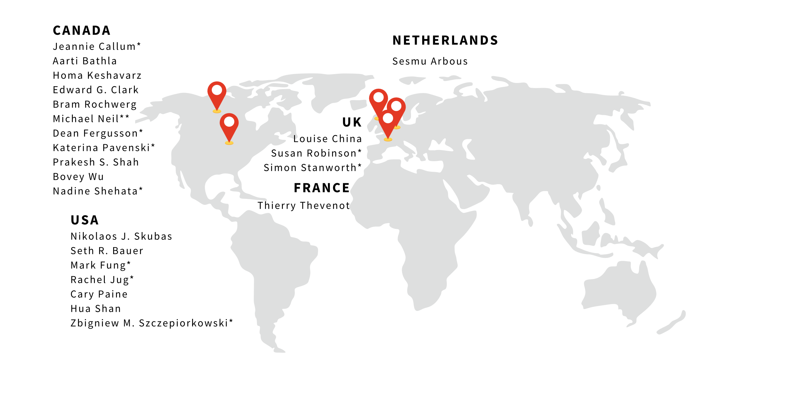
ICTMG’s albumin guideline development
The guideline development group included an international panel of expert volunteers:
* denotes ICTMG full membership at the time of guideline development
** indicates patient representation
Notes:
The guideline development group for this guideline included the following group of international experts as authors (listed on slide). Authors of the intravenous albumin guideline have no financial or intellectual conflicts of interest to declare. The ICTMG receives funding from Canadian Blood Services; Canadian Blood Services does not influence the content of the guidelines.
The clinical question for this guideline, which was developed following the Population (P), Intervention (I), Comparison ©, Outcome (O) format (PICO) focused on the comparison of albumin to alternative interventions in populations commonly prescribed albumin on mortality and other clinically important outcomes as identified by the panel of experts for adults and pediatric patients.
The guideline panel consisted of 2 co-chairs and other members including researchers, clinicians, methodologists, and a patient representative
A systematic literature review and meta-analyses were conducted
Systematic review protocol was registered in PROSPERO and conducted in accordance with PRISMA 2020 guidelines
Key search terms were identified by the guideline panel based on the PICO questions
Search strategy developed by a librarian, and the search was conducted in multiple databases from inception to November 23, 2022
References were screened and relevant data extracted and analysed using Distiller SR
Based on the evidence, recommendations were developed using Grading of Recommendations Assessment, Development and Evaluation (GRADE) methodology
The quality of evidence was assessed using Cochrane risk of bias instrument for RCTs and AMSTAR assessment for Systematic Reviews.
The certainty of evidence for recommendations was assessed using GRADE
The guideline recommendations were developed and reported in accordance with the AGREE checklist

Slide 9

The guideline's key messages
Key target audiences for the guideline include…
Primary
TM physicians
Cardiac surgeons
Anesthesiologists
Gastroenterologists
Hepatologists
General internal medicine
Nephrologists
Critical care physicians (adult and pediatric)
Intensivists
MLTs in blood banks
Perfusionists in cardiac operating rooms
Nurses
Secondary
Organizations that make decisions/policies about transfusion practice (e.g., hospitals)
Organizations that promote best practices (e.g., AABB, ISBT, ABO)
Patients:
  undergoing cardiac and non-cardiac surgery, kidney replacement therapy, with cirrhosis, and in critical care with severe infections.

Slide 10
The guideline's key messages
Key messages for health-care professionals include…
Twelve of the 14 recommendations do not suggest albumin use in a wide variety of clinical situations where it is commonly transfused.
This guideline provides actionable recommendations on the use of albumin, a human-derived blood product manufactured from donated human plasma.
Practice audits show highly variable use of albumin between regions.
There are currently few evidence-based indications that support the routine use of albumin in clinical practice to improve patient outcomes.
Source: Callum J, Skubas NJ, Bathla A, Keshavarz H, Clark EG, Rochwerg B, Fergusson D, Arbous S, Bauer SR, China L, Fung M, Jug R, Neill M, Paine C, Pavenski K, Shah PS, Robinson S, Shan H, Szczepiorkowski ZM, Thevenot T, Wu B, Stanworth S, Shehata N, on behalf of the ICTMG Intravenous Albumin Guideline Group, Use of Intravenous Albumin: A Guideline from the International Collaboration for Transfusion Medicine Guidelines., CHEST (2024), doi: 10.1016/j.chest.2024.02.049

Slide 11
The guideline's key messages
Key messages for researchers include…
The risk of intravenous albumin infusions needs further investigation to allow clinicians to appropriately weigh the risk-benefit profile.
    Studies should include patient-important outcomes
Future research is needed in multiple clinical settings including:
    role and timing of albumin in patients with sepsis or other conditions with insufficient response to crystalloids
    role of albumin in patients undergoing non-cardiac surgery; for intradialytic hypotension; and for patients with cirrhosis
Source: Callum J, Skubas NJ, Bathla A, Keshavarz H, Clark EG, Rochwerg B, Fergusson D, Arbous S, Bauer SR, China L, Fung M, Jug R, Neill M, Paine C, Pavenski K, Shah PS, Robinson S, Shan H, Szczepiorkowski ZM, Thevenot T, Wu B, Stanworth S, Shehata N, on behalf of the ICTMG Intravenous Albumin Guideline Group, Use of Intravenous Albumin: A Guideline from the International Collaboration for Transfusion Medicine Guidelines., CHEST (2024), doi: 10.1016/j.chest.2024.02.049

Slide 12
The guideline's key messages
Key messages for researchers include…
More studies will be needed to:
    evaluate the role and timing of albumin as a rescue fluid in patients with sepsis failing front-line crystalloid resuscitation;
    understand the pathophysiology of intradialytic hypotension, to determine if albumin prevents intradialytic hypotension or improves ultrafiltration, mitigates associated symptoms, or improves patient-important outcomes;
    understand therapeutic targets of albumin resuscitation (hemodynamic, urinary output, laboratory), the optimal formulation for each indication, and the dosing strategy.
Source: Callum J, Skubas NJ, Bathla A, Keshavarz H, Clark EG, Rochwerg B, Fergusson D, Arbous S, Bauer SR, China L, Fung M, Jug R, Neill M, Paine C, Pavenski K, Shah PS, Robinson S, Shan H, Szczepiorkowski ZM, Thevenot T, Wu B, Stanworth S, Shehata N, on behalf of the ICTMG Intravenous Albumin Guideline Group, Use of Intravenous Albumin: A Guideline from the International Collaboration for Transfusion Medicine Guidelines., CHEST (2024), doi: 10.1016/j.chest.2024.02.049

Slide 13
Guideline dissemination & implementation
Tools available to support awareness of the guideline and uptake of its recommendations into practice include:
Breakthroughs in Blood webinar recording, including panel discussion by international clinical experts
Mythbusters downloadable FAQ & sharable social media tiles for encouraging evidence-based decisions about albumin use
Clinical Guide to Transfusion, Chapter 3, providing a comprehensive overview of albumin in Canada
Scan to access these tools on ICTMG.org
Notes:
We invite you to check out how this guideline is being shared, endorsed, and/or implemented by ICTMG's members and partner organizations internationally, and to use the tools to cascade information in your own networks and practice areas.

Slide 14
Guideline dissemination & implementation
Tools available to support awareness of the guideline and uptake of its recommendations into practice include:
ISBT Journal Club webinar recording, reviewing the evidence used to develop the guideline
Critical Matters Podcast, a free-to-access conversation about albumin in critical care (50 minutes)
Selection of blog, newsletter and commentary articles, discussing the application and impact of the guideline’s recommendations on practice
and more…
Scan to access these tools on ICTMG.org
Notes:
We invite you to check out how this guideline is being shared, endorsed, and/or implemented by ICTMG's members and partner organizations internationally, and to use the tools to cascade information in your own networks and practice areas.

Slide 15
Contact ICTMG
The ICTMG Secretariat is hosted by Canadian Blood Services, the primary funder for ICTMG.

Slide 16

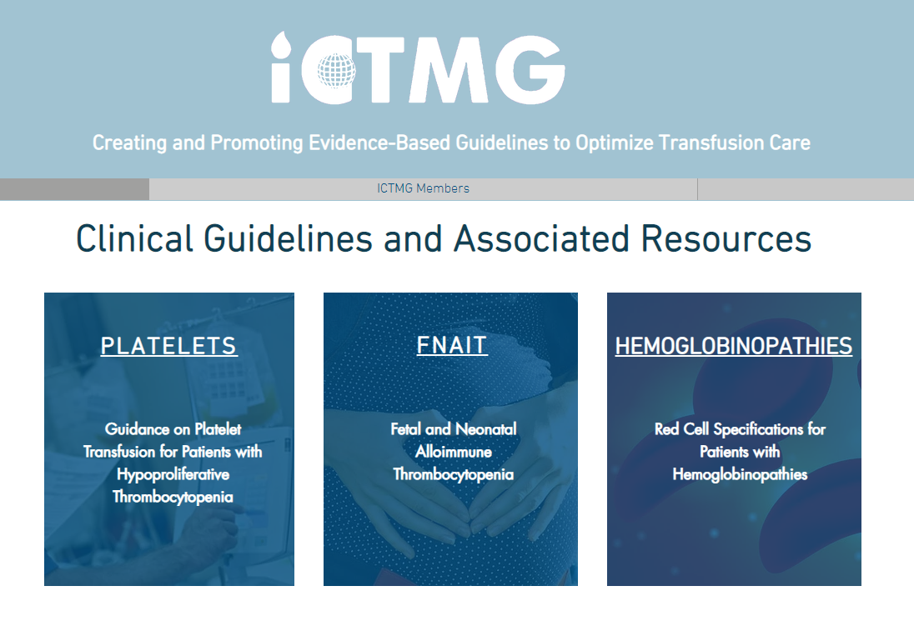
For more information about ICTMG and this albumin guideline:
Visit www.ICTMG.org (or scan this QR-code to access the site)
Email: info@ictmg.org
Notes:
For more information on the intravenous albumin publications and to access the additional resources for physician and patients, visit www.ICTMG.org or email info@ictmg.org.

